Slide 1
Project-1
Fruit Prices 2023
Student: Angela Bonilla
Course: Data 110
10/28/26

Slide 2

Fruit prices have been known to fluctuate over the years, but it is an interesting concept to think of what the price of fruit products will be based on the type of fruit and the form in which it is sold (fresh, frozen, canned, dried, juice, etc.). This project aims at exploring a 2023 fruit-price dataset and investigating differences in fruit-product costs through visualizations of data. The analysis is based on average price per cup equivalent, providing a common measure to compare the estimated cost of equivalent amounts of fruit.
Why this Dataset?
Link: https://www.ers.usda.gov/media/6210/all-fruits-average-prices-csv-format.csv?v=60447

Slide 3

Columns Used
Columns Not Used
Fruit: Different fruit variations. 62 total units.
Form: Fresh, frozen, canned, dried, and juice
Average Retail Price: Average price when sold to stores in any form
Size of a Cup Equivalent: Total units in a cup
Average Price per Cup Equivalent: Overall average price per cup.
Preparation Yield Factor: What it cost to produce
Average Retail Price Unit of Measure: Average units measured to produce
Cup Equivalent Unit of Measure: Units measured in cup.
Dataset Research Question: How does the form of fruit affect its cost, and which fruit product offers the lowest cost per cup equivalent?

Slide 4

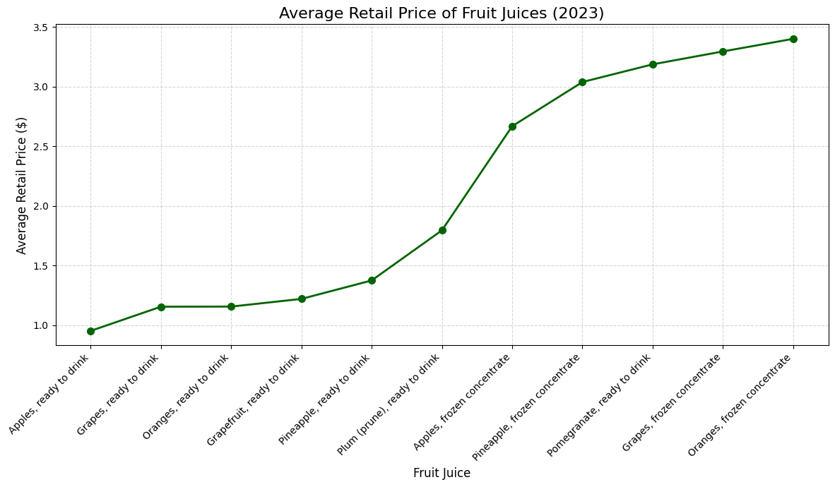
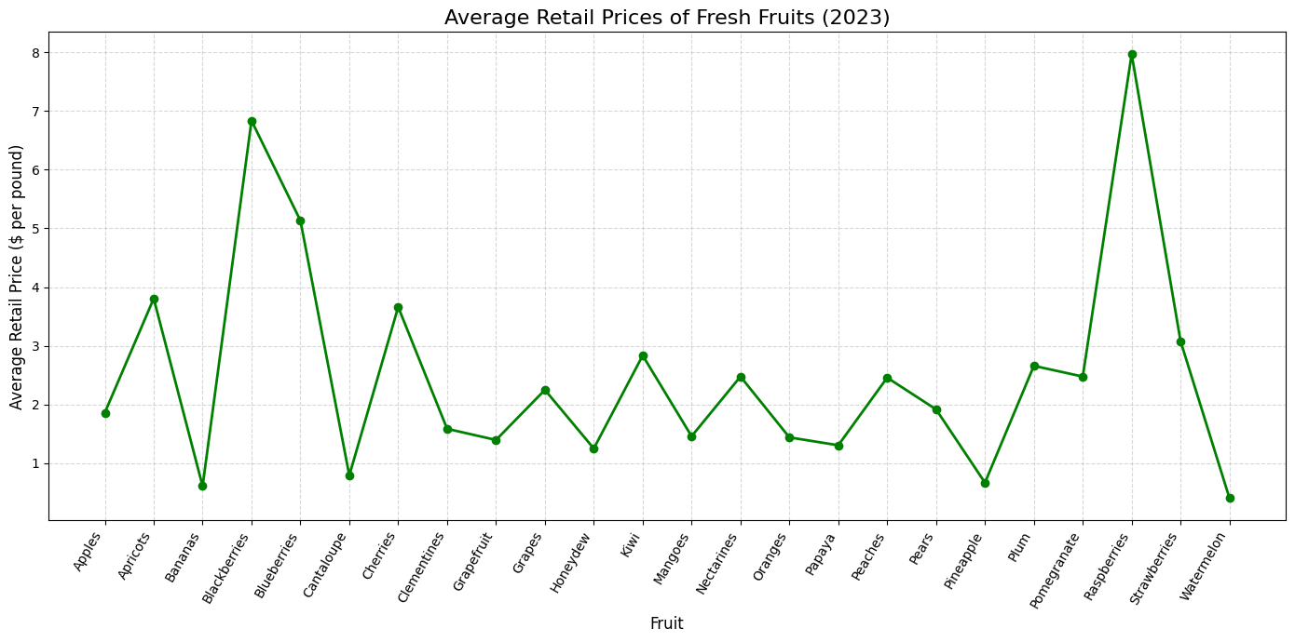
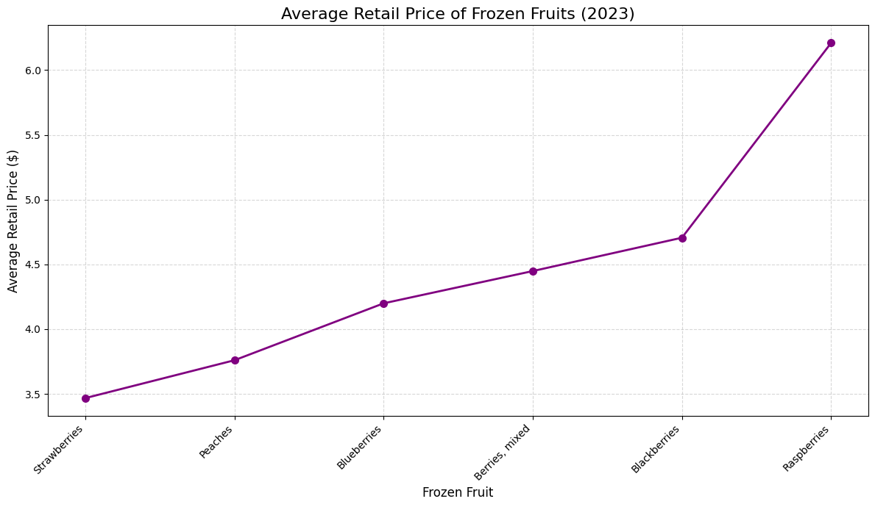
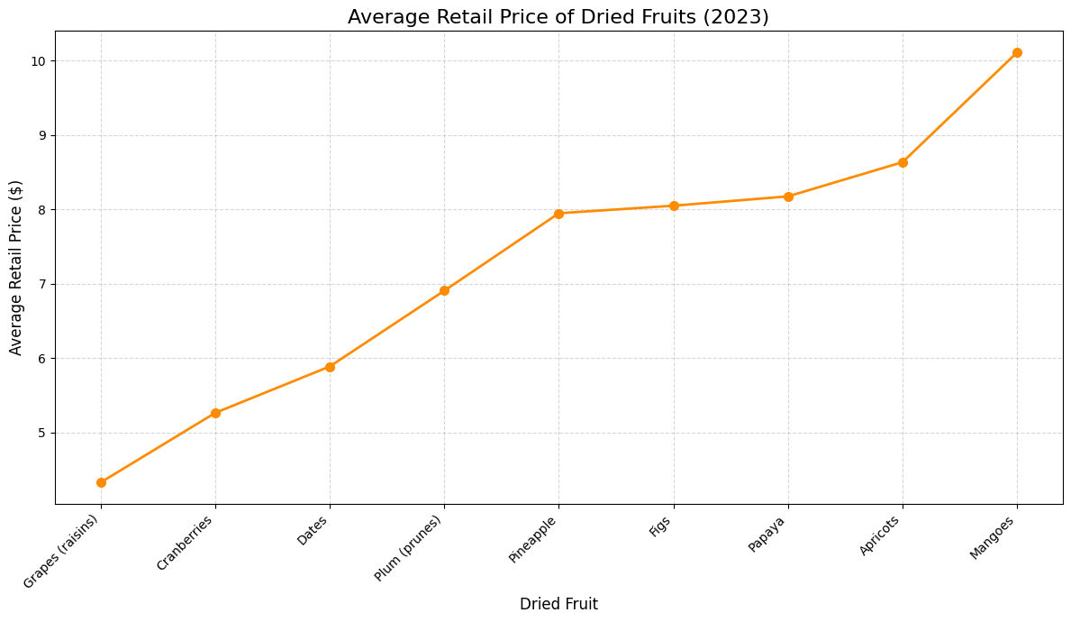
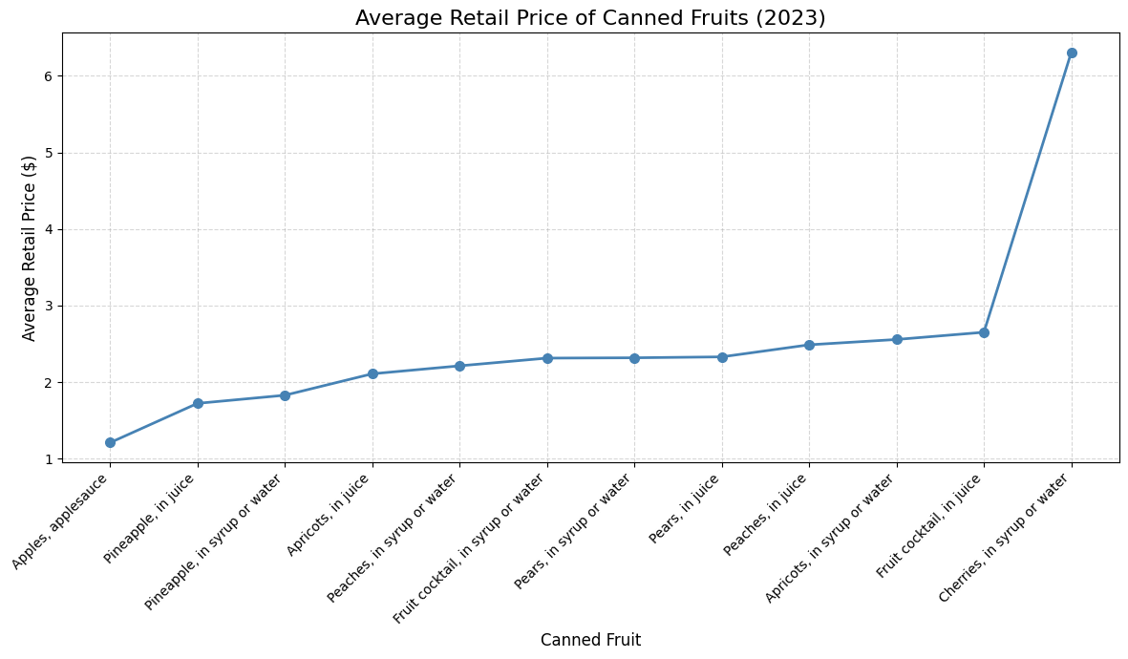
Line Graph: Average Retail Prices of Fresh, Frozen, Dried, Canned, and Juiced Fruits
Within these line graphs are the different variations of fruits in different forms of production. Each graph has more or less of a certain fruit in a certain form, and upon further observation each graph is organized from most inexpensive to most expensive fruit in production.

Slide 5

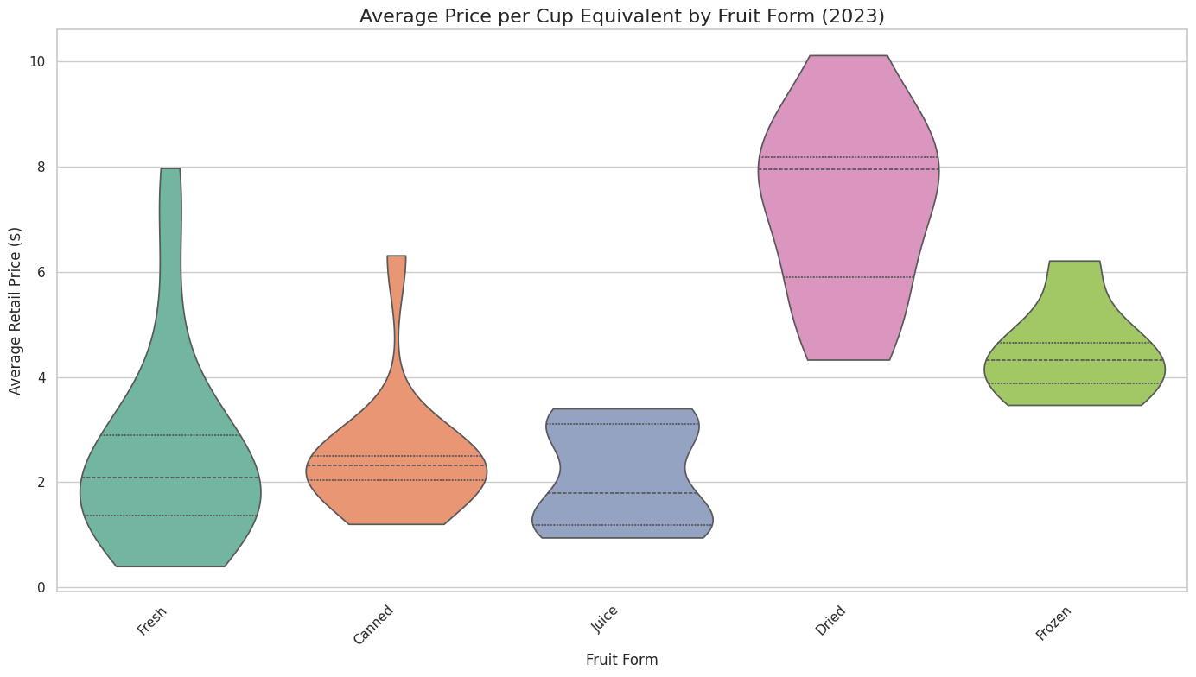
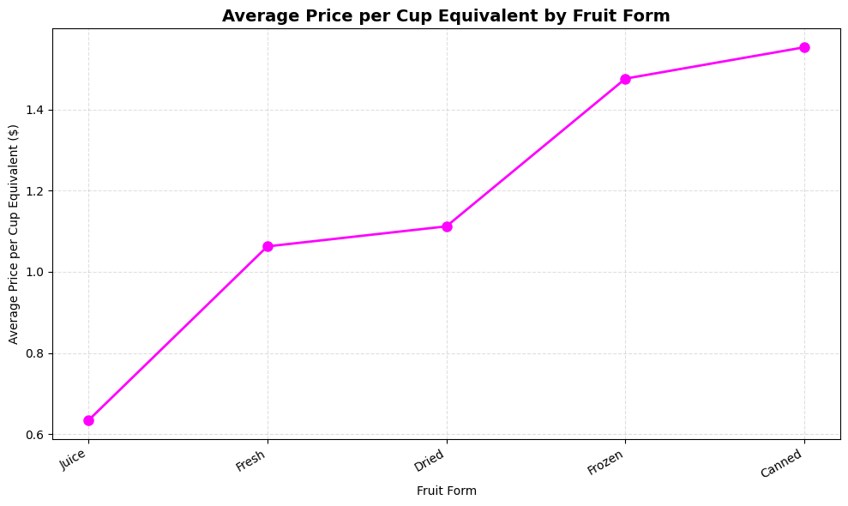
Line and Violin Graph: Average Price per Cup Equivalent by Fruit Form
The two graphs provided consist of a line graph (easy to understand) and a violin graph ( visually appealing), and though different they both compare the average price for a different forms ordered in increasing average prices.

Slide 6

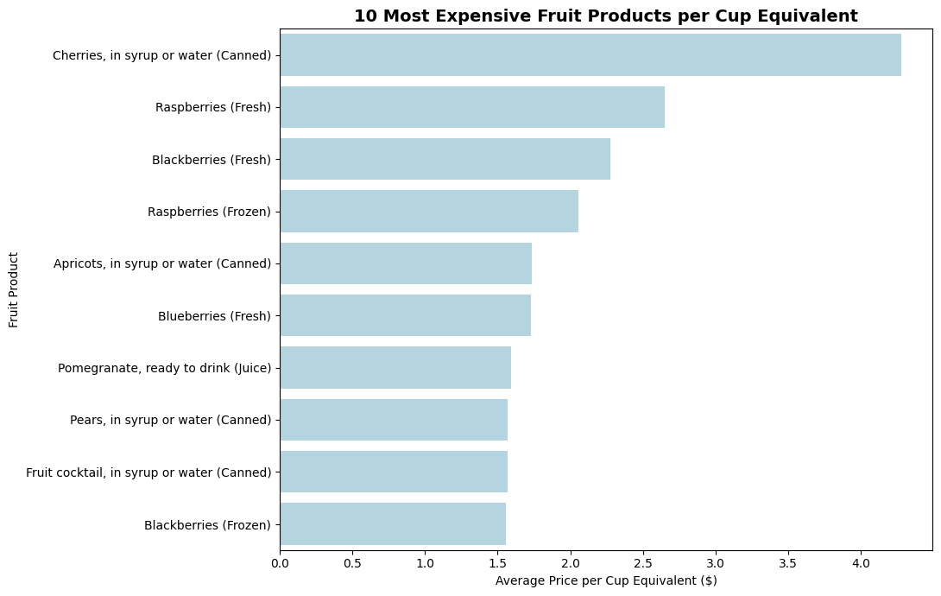
Bar Graph: Which Fruit Product Cost The Most Per Cup Equivalent?
This bar graph gives us the first look into part of the research question. Before getting the answer to a question, it is best to find the imbalance to follow up our question. Take into consideration the most expensive before comparing the least expensive.

Slide 7
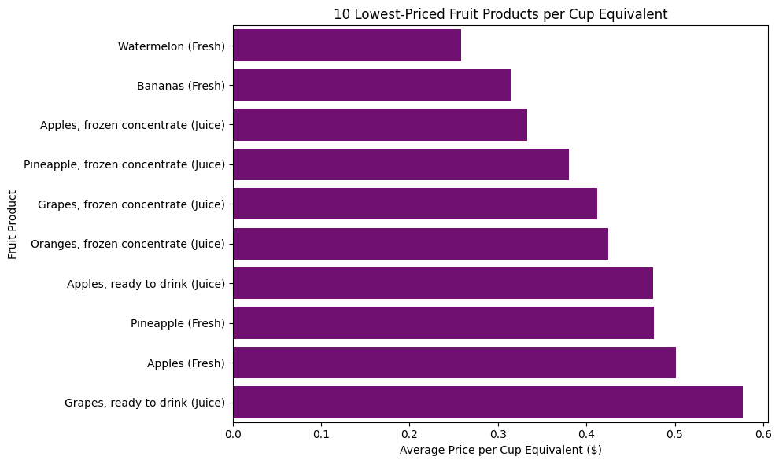
Bar Graph: Which Product Offers the Lowest Cost Per Cup Equivalent?
The bar graph compares the ten fruit product records with the lowest average price per cup equivalent. The chart not only answers our research question but identify relatively inexpensive options for consumers in 2023.

Slide 8
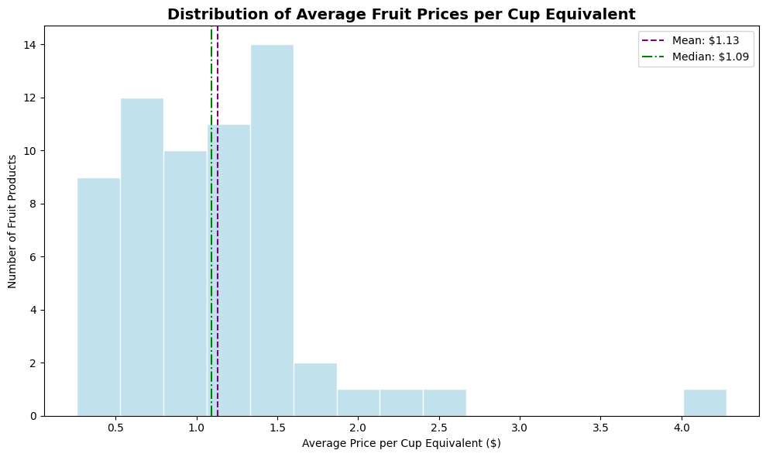
Histogram: Distribution of Average Fruit Prices per Cup Equivalent
The histogram displays the average prices per cup for fruit products, with bars indicating the count in each price range. Mean and median lines help compare overall averages to the middle price, revealing common price ranges and the effect of expensive products.

Slide 9

Summarized Report and Conclusion
This project analyzed the 2023 fruit price dataset, focusing on cup-equivalent prices and variations across fruit forms. Visualizations illustrated price ranges and demonstrated how data visualization aids in understanding prices. Limitations include the dataset's average prices, which may not reflect current grocery costs. Overall, it showcased how Python and visualization reveal fruit price patterns effectively.

Slide 10
Thank you

